Slide 1
LP-II Mini Projects
Ashish Kumar
Tejas Bhavsar
Tanmay Thole

Slide 2
Loan Prediction using Classifiers
Mini Project – I (DMW)

Slide 3
PROBLEM STATEMENT
Consider a labeled dataset belonging to an application domain. Apply suitable data preprocessing steps such as handling of null values, data reduction, and discretization. For prediction of class labels of given data instances, build classifier models using different techniques (minimum 3), analyze the confusion matrix and compare these models. Also apply cross validation while preparing the training and testing datasets.

Slide 4
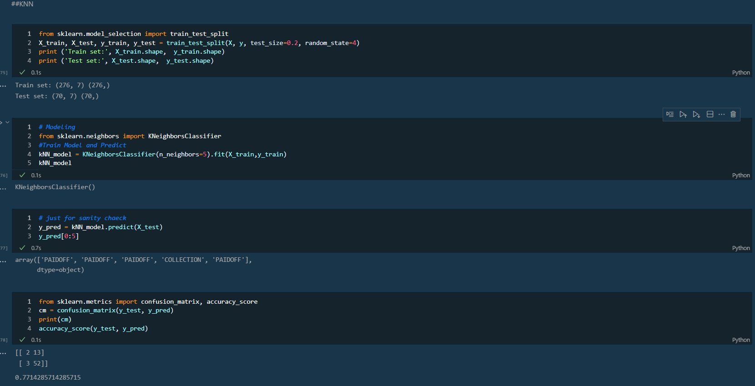
KNN
MODULES USED

Slide 5
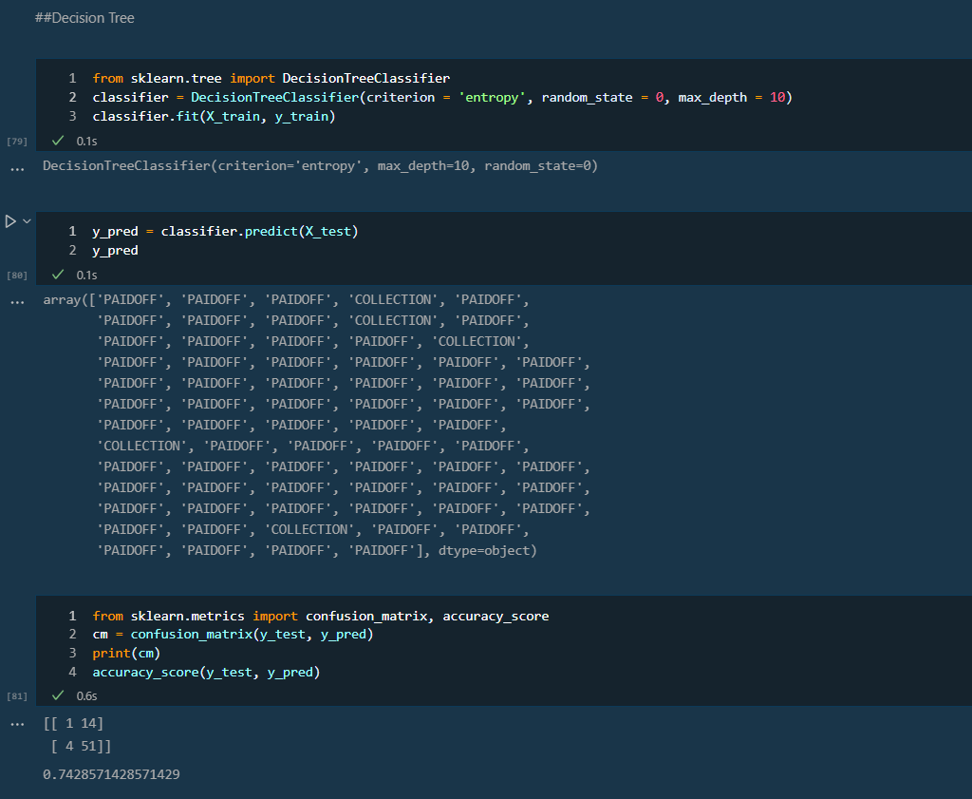
Decision Tree

Slide 6
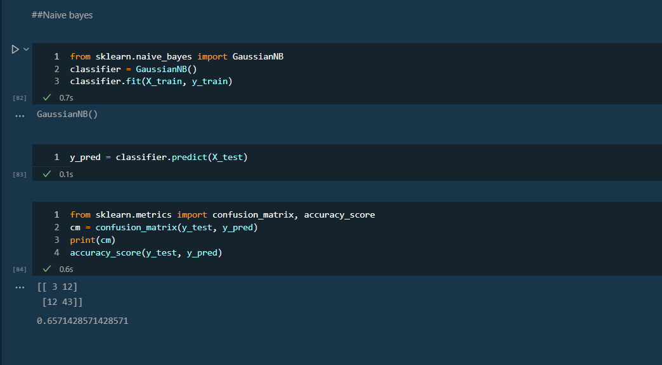
Naive Bayes

Slide 7
Performing Unit Testing on Python web app
Mini Project – II (STQA-I)

Slide 8
PROBLEM STATEMENT
Create a small application by selecting relevant system environment / platform and programming languages. Narrate concise Test Plan consisting features to be tested and bug taxonomy. Prepare Test Cases inclusive of Test Procedures for identified Test Scenarios. Perform selective Black-box and White-box testing covering Unit and Integration test by using suitable Testing tools. Prepare Test Reports based on Test Pass/Fail Criteria and judge the acceptance of application developed.

Slide 9
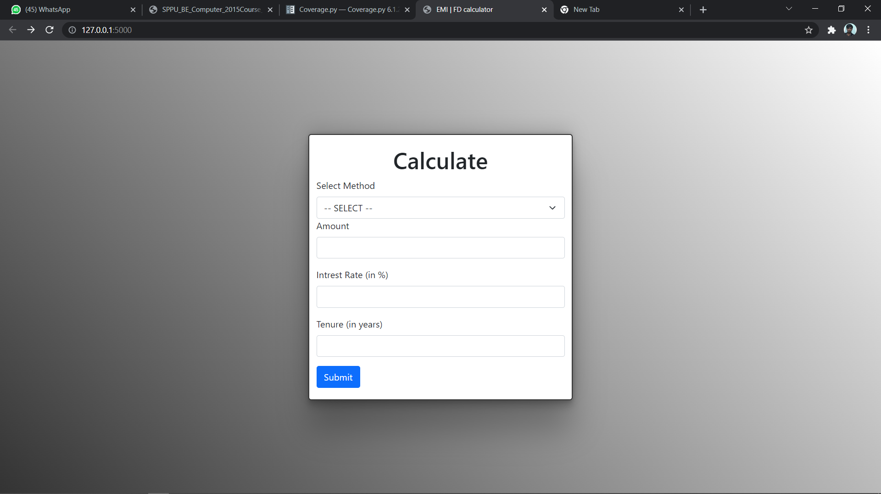
Project Interface

Slide 10
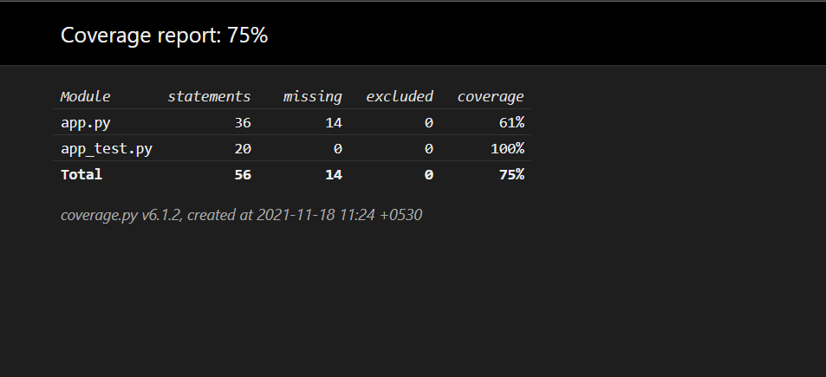
Coverage Report

Slide 11
Performing Testing on Discussion Forum Website
Mini Project – III (STQA-II)

Slide 12
PROBLEM STATEMENT
Create a small web-based application by selecting relevant system environment / platform and programming languages. Narrate concise Test Plan consisting features to be tested and bug taxonomy. Narrate scripts in order to perform regression tests. Identify the bugs using Selenium Web Driver and IDE and generate test reports encompassing exploratory testing.

Slide 13
PRE-REQUISITES
PHP
XAMPP server
Python
Selenium
VS Code

Slide 14
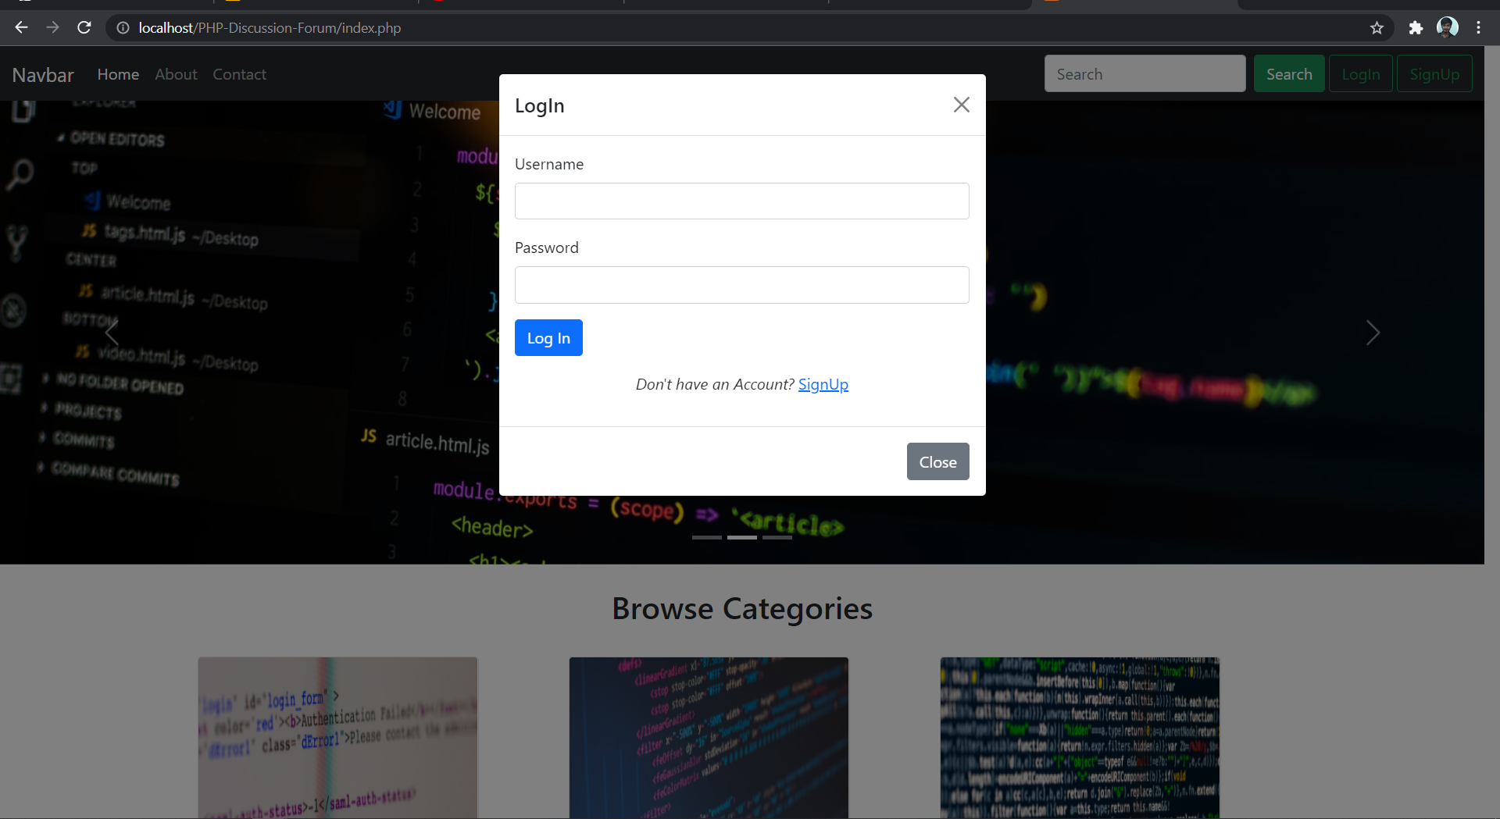
Project Interface

Slide 15
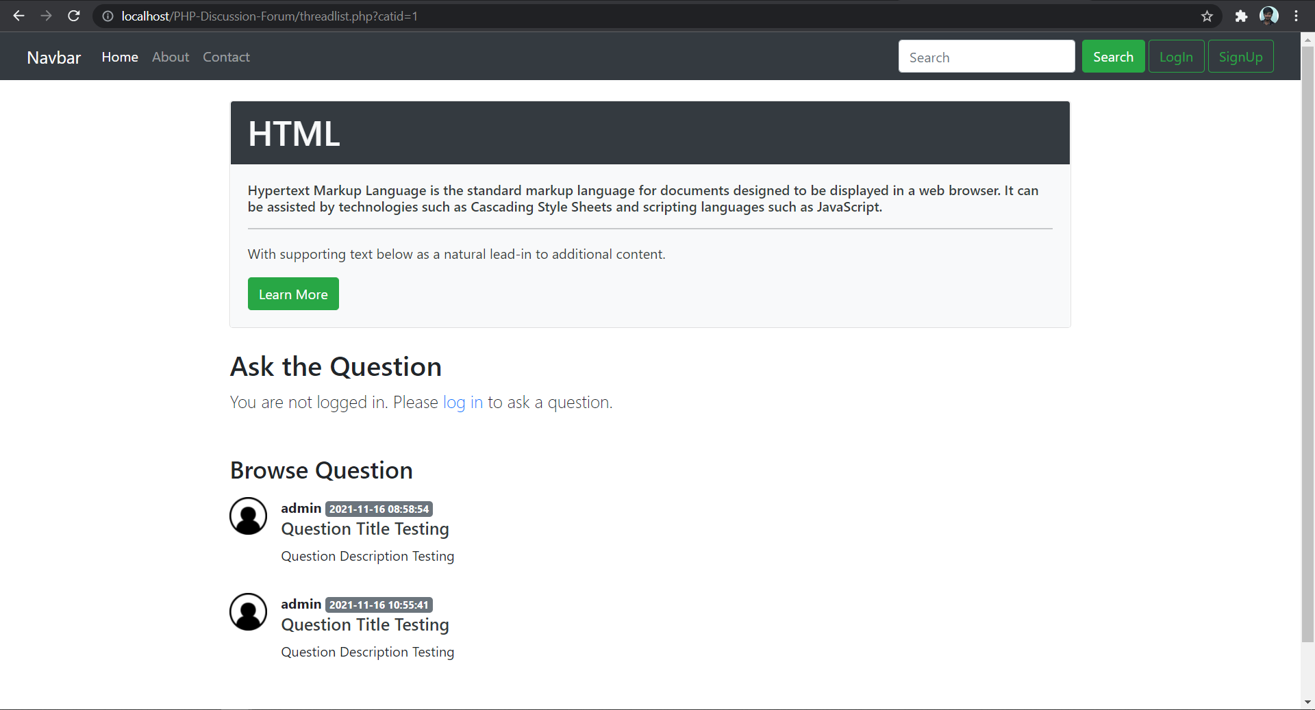

Slide 16
Selenium Testing and Result

Slide 17
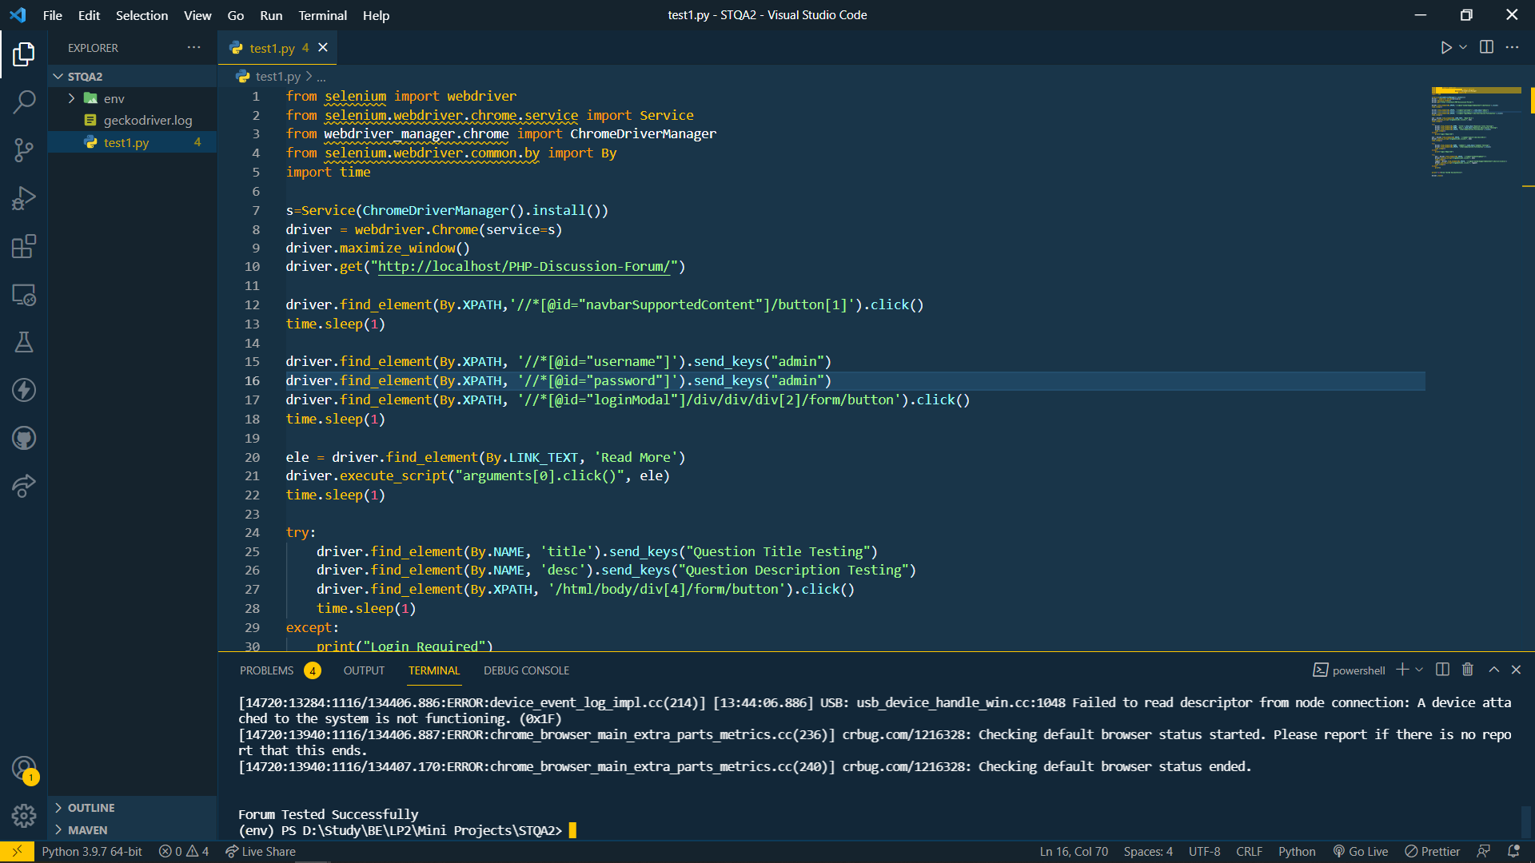

Slide 18
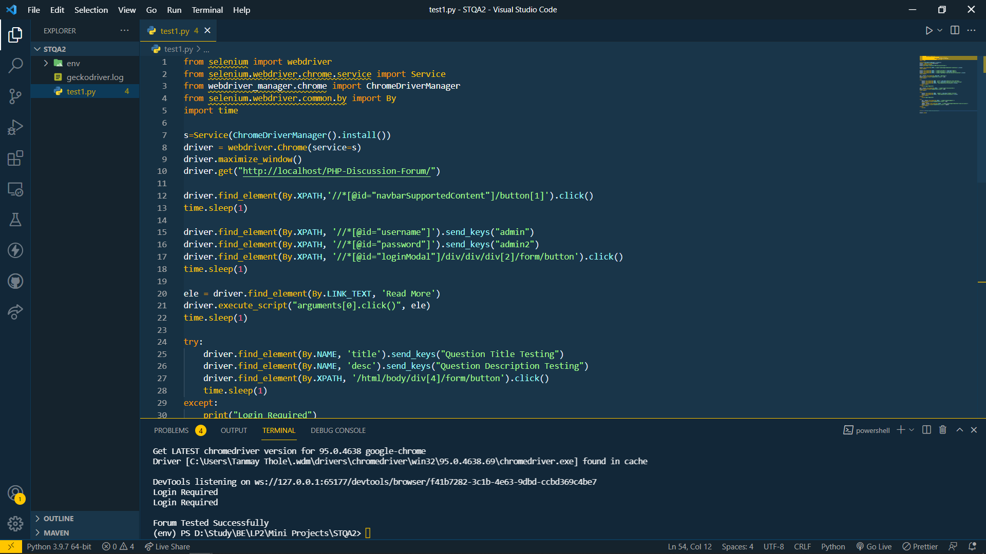

Slide 19
Thank You

